Slide 1

university of Europe for applied sciences Department of Data Science
Presentation On: progress report Twitter (X) Real-Time Data Engineering Pipeline
PRESENTED BY:
Anish Dadaji Khobragade
Bhuvan Chandra
Sainath Reddy
GUIDED BY:
Prof. Farhan Khan

Slide 2
Contents:
1. | Introduction
2. | Aim &Objective
3. | Flow of Work
4. | Technologies
5. | Data
6. | Data Preparation

Slide 3
Problem Definition
Traditional data systems are not efficient for handling continuously generated real-time social media data. Processing and analyzing large volumes of streaming tweet data requires a scalable and reliable data pipeline. The main problem addressed in this project is how to efficiently stream, process, and visualize real-time Twitter (X) sentiment data using Apache Kafka and modern data engineering tools.

Slide 4
Introduction
This project focuses on building a real-time Twitter (X) data engineering pipeline using Apache Kafka, Python, and Power BI. The system streams tweet data in real time through a Kafka Producer-Consumer architecture and processes the data for analytics and visualization. The project demonstrates important data engineering concepts such as real-time streaming, distributed messaging, data ingestion, and dashboard-based analytics.

Slide 5
Aim & Objectives:
Aim
To develop a real-time Twitter (X) data streaming pipeline using Apache Kafka, Python, and Power BI for processing and visualizing tweet sentiment data.
Objectives
To implement real-time data streaming using Apache Kafka.
To develop Producer and Consumer applications using Python.
To process tweet data using Kafka topics.
To visualize streaming analytics using Power BI.

Slide 6
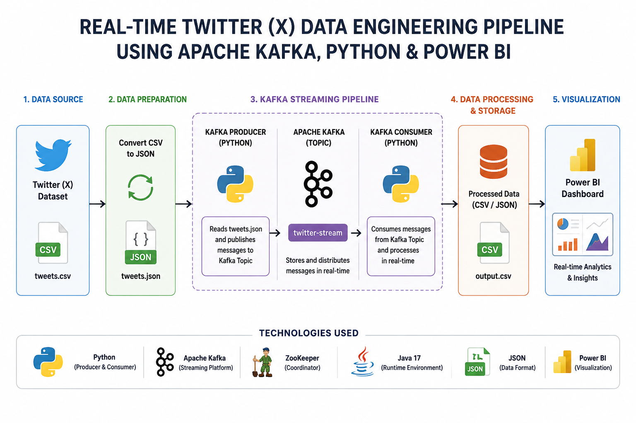
Methodology

Slide 7
Technology :
Python – Used for Kafka Producer and Consumer development
Apache Kafka – Used for real-time data streaming
Zookeeper – Used for Kafka coordination and management
Java 17 – Runtime environment required for Kafka services
JSON – Used as the streaming data format
Power BI – Used for analytics and dashboard visualization

Slide 8
Data:
Dataset Information
Twitter (X) sentiment dataset used for real-time streaming simulation
Original dataset collected in CSV format
Dataset converted into JSON format for Kafka streaming
Dataset contains:
Tweet_id
entity
sentiment
tweet text
Used for real-time analytics and sentiment visualization in Power BI

Slide 9
Preprocessing of Data:
Removing Null Values
Converting Data Types
Normalizing Data
Feature selection
Removing Outliers

Slide 10
PROGRESS
Installed and configured Apache Kafka and Zookeeper.
Configured Java 17 environment for Kafka services.
Converted CSV dataset into JSON format for streaming.
Developed Kafka Producer and Consumer using Python.
Successfully implemented and verified real-time tweet streaming pipeline.
Current project completion status is approximately 70%.

Slide 11
Thank You!

